Slide 1
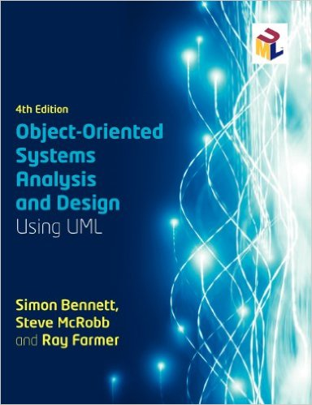
ITOO311
TEXTBOOK
Chapter 3
WEEK 2

Slide 2
3.3 Project Lifecycles
Use systematic approach when developing systems

Slide 3
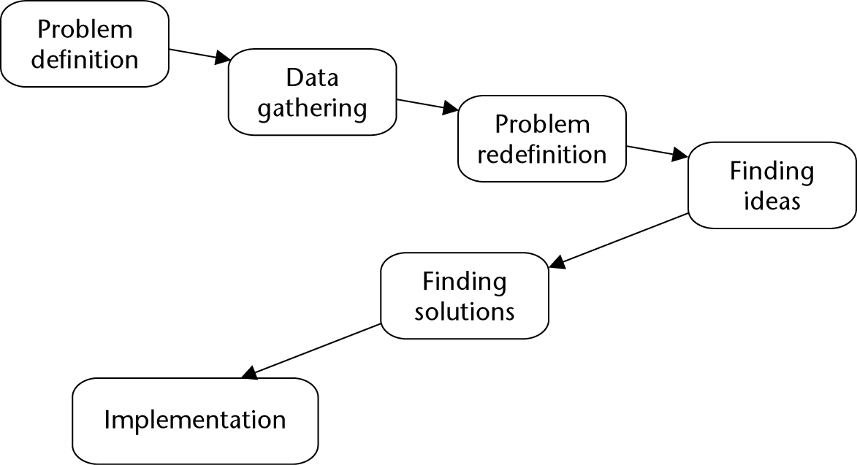
Problem-solving model

Slide 4
Activity:
Apply to problem of global warming

Slide 5
3.3.1 Waterfall lifecycle model
There are many variations

Slide 6
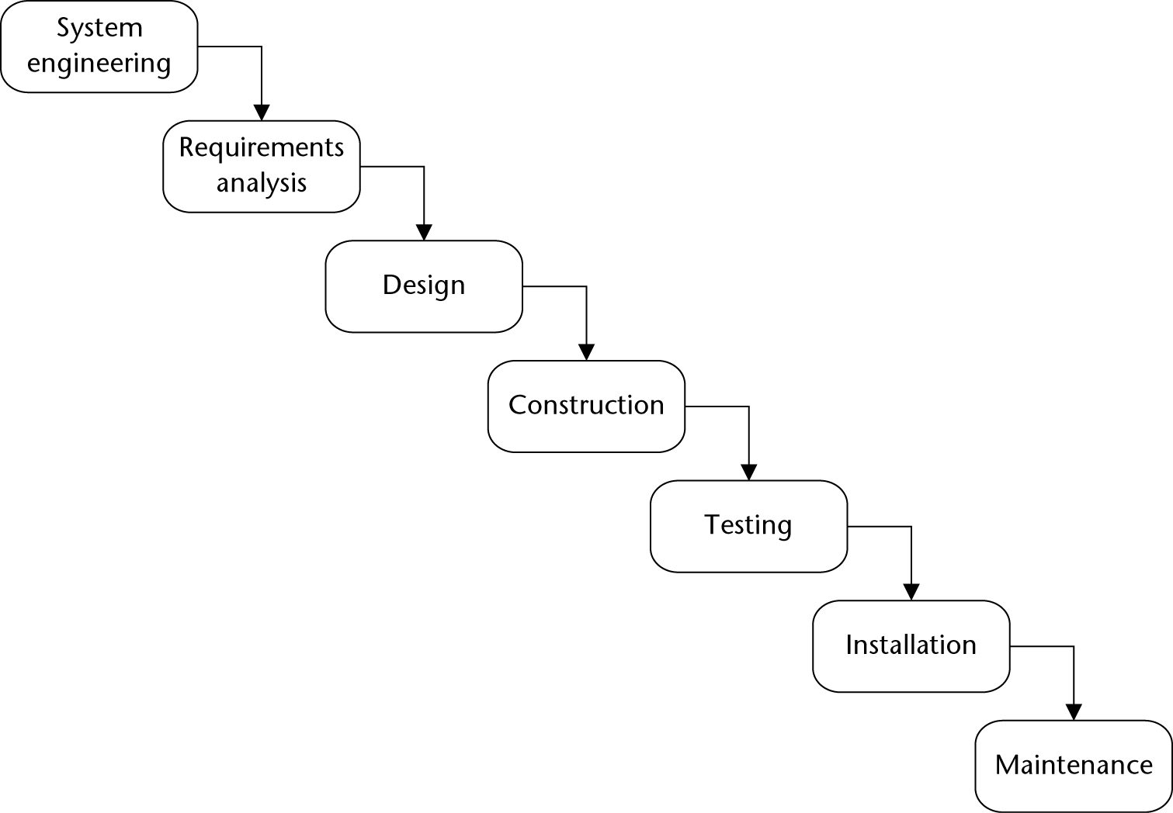
Presentation Title runs here l 00/00/00

Slide 7
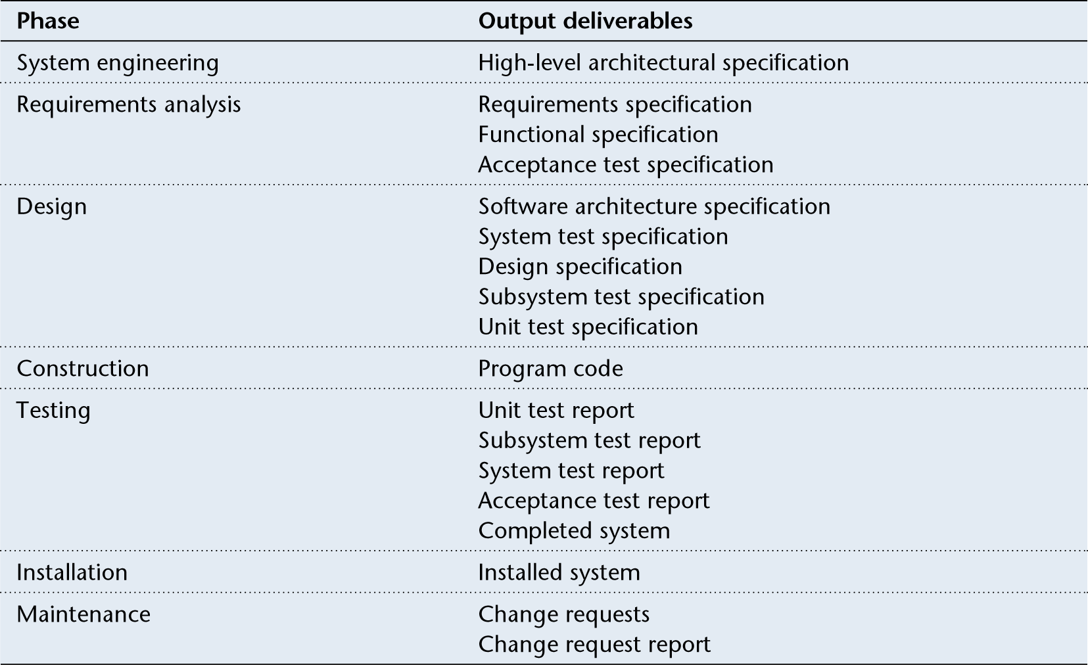
Lifecycle deliverables

Slide 8
Waterfall criticisms
Sequential
Task repetition
Requirements change
Unresponsive to changes

Slide 9
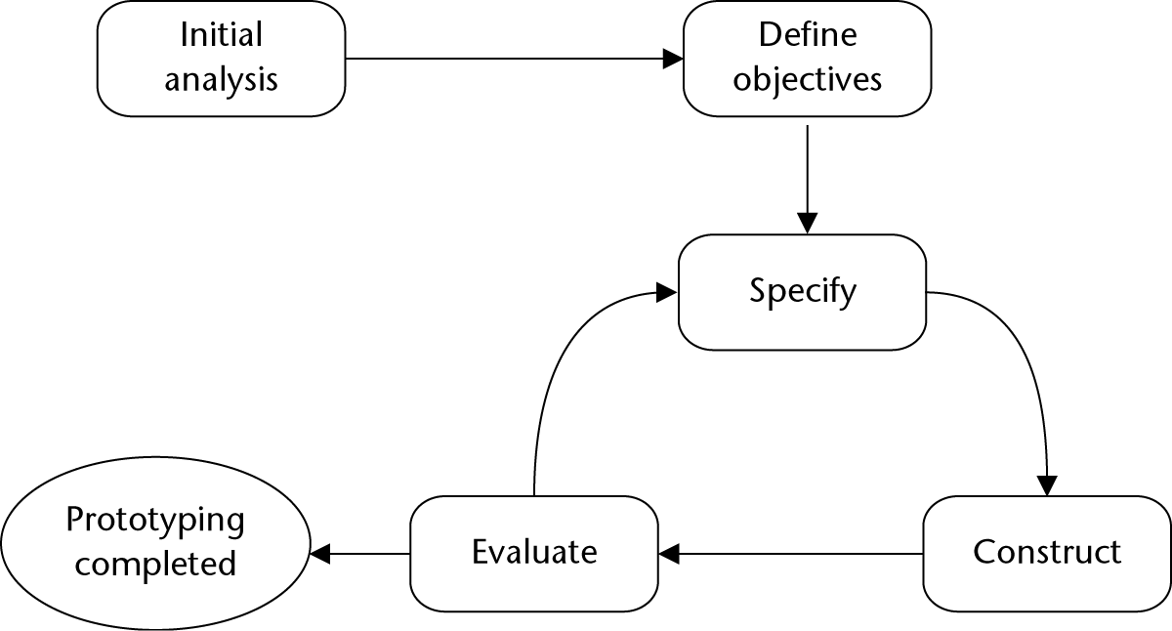
3.3.2 Prototyping
Lifecycle

Slide 10
3.3.2 Prototyping
Advantages (interface difficulties identified, early demonstrations, system usability tested, etc.)
Problems (client might think final systems, only focus on interface, requires significant user involvement, etc.)

Slide 11
3.3.3 Iterative and incremental
Iteration: mini-project
Small IS growing incrementally = successful large IS
Spiral – focus on RISK ANALYSIS

Slide 12
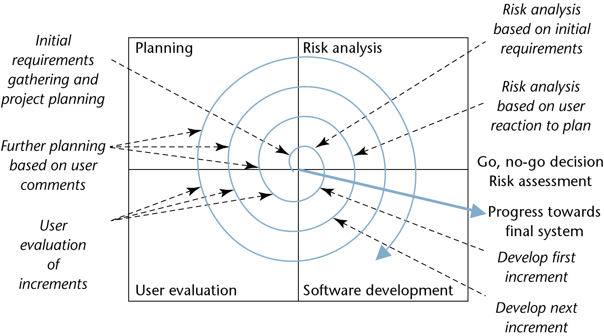
Presentation Title runs here l 00/00/00

Slide 13
3.4 Methodological Approaches
Systematic approach to IS development
Techniques used in specific approaches
O-O focuses on iterative approach

Slide 14
3.4.1 USDP
Single methodological approach for O-O… UML defined from this
IBM RUP 1999 – after USDP
EUP – RUP extension (2 more phases – production & retirement)

Slide 15
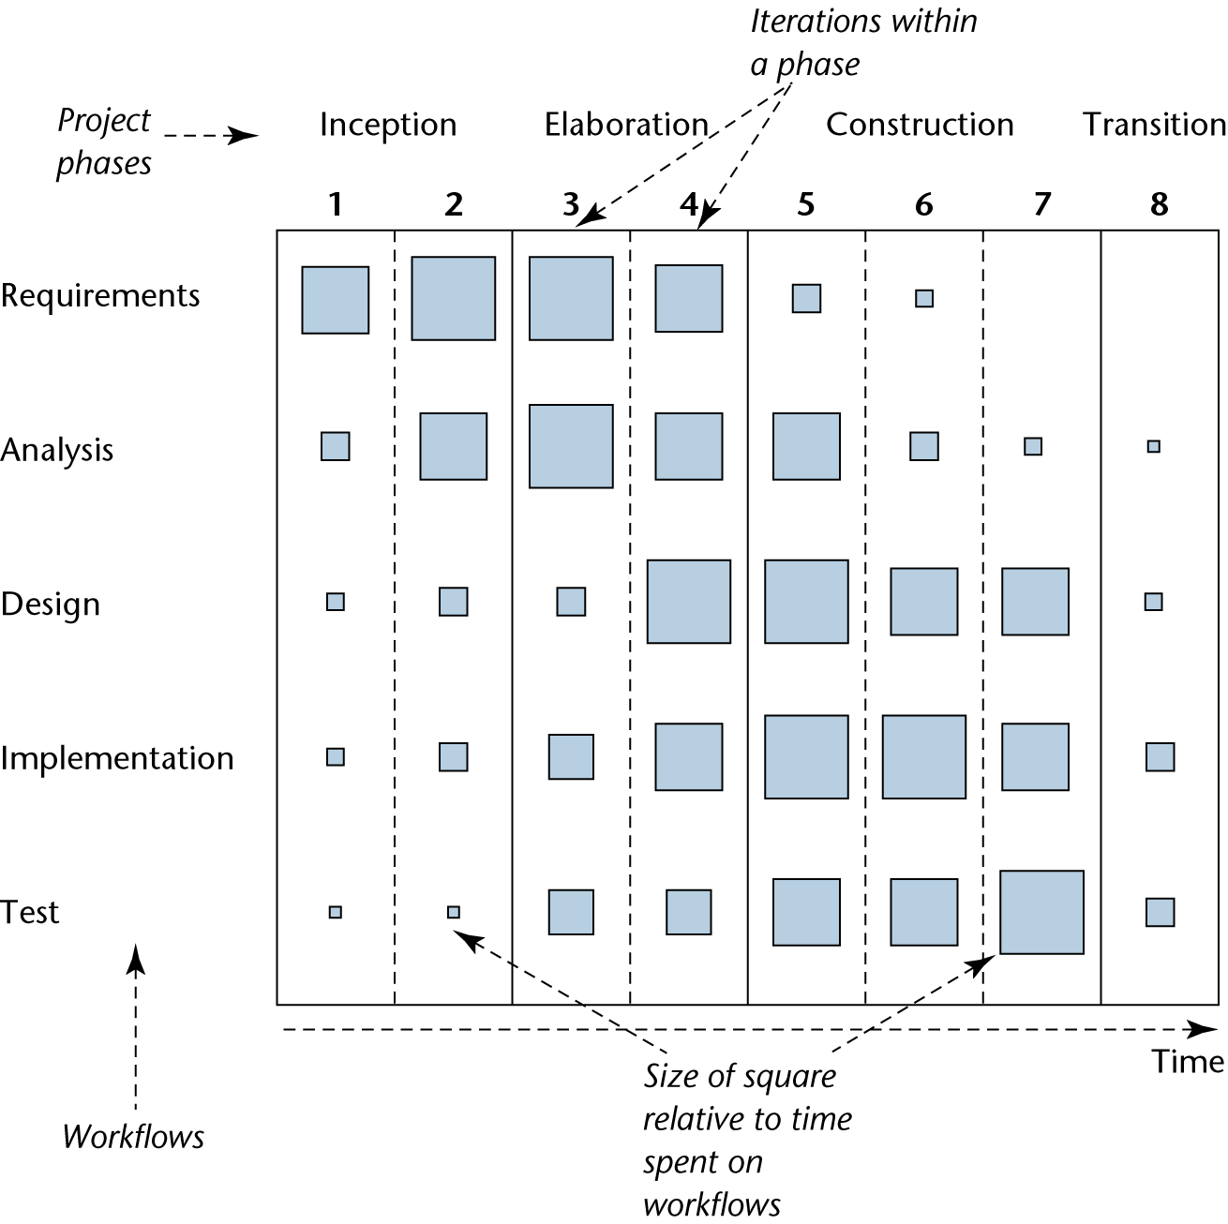
Presentation Title runs here l 00/00/00

Slide 16

3.4.2 Agile Approaches
A group met in February 2001 and produced a manifesto for Agile software development

Slide 17
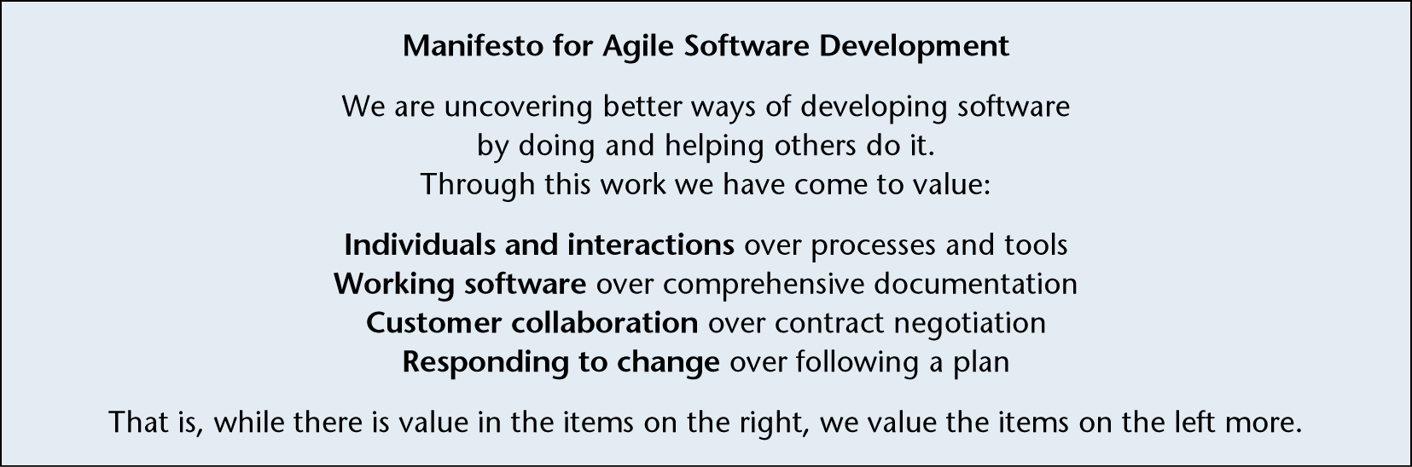
Presentation Title runs here l 00/00/00

Slide 18
Many agile methodologies
XP (eXtreme Programming)
SCRUM
DSDM
etc.
Need an experienced team for Agile

Slide 19
3.5 Managing IS Development
RUP – 3 supporting disciplines:
Configuration management: document version control and change requests
Project management: project planning and control
Environment: tools available for approach

Slide 20
3.5.1 Iterative lifecycle
Supports agile approaches and offers:
Risk mitigation (minimise unpleasant surprises)
Change management (supports change)
Team learning (team involved from start)
Improved quality (test early)

